Slide 1
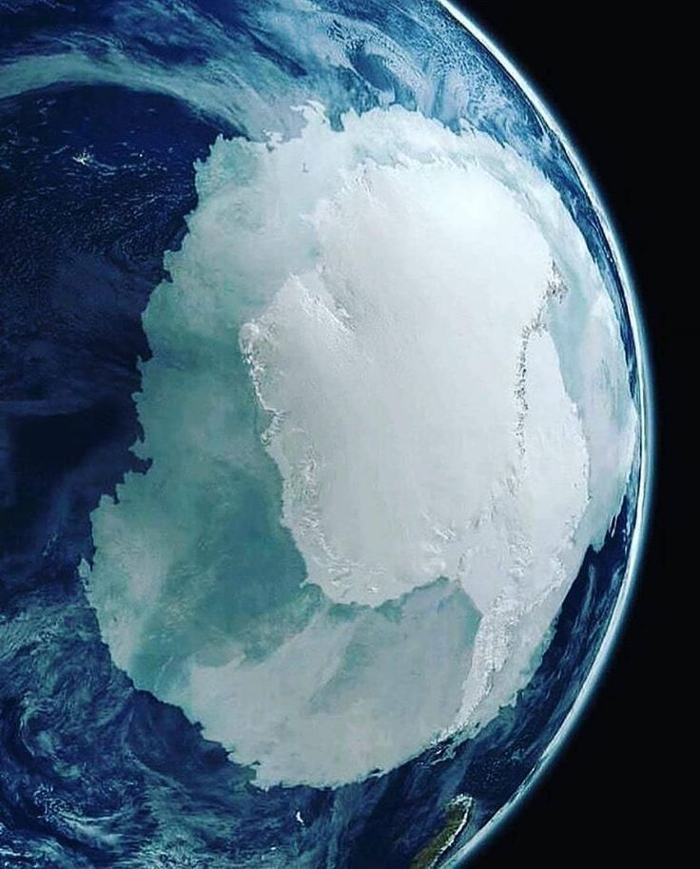
Glacier Facies Classification using SAR –Backscatter and Glacier Velocity Mapping of Pine Island Glacier.
Supervisor
Dr. Praveen K. Thakur
HOD - Water Resource Department
Submitted by
VIVEK KUMAR
M.Tech, Geo Informatics Department
IIRS2021021511761

Slide 2

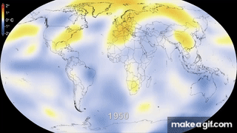
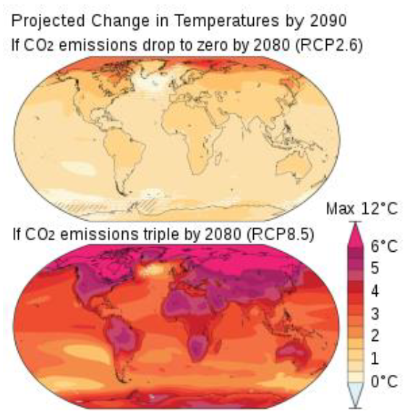
BACKGROUND
GHG CONCENTRATIONS
RISING TEMPERATURE
EXTREME WEATHER
GLACIER RETREAT
SEA-LEVEL RISE

Slide 3
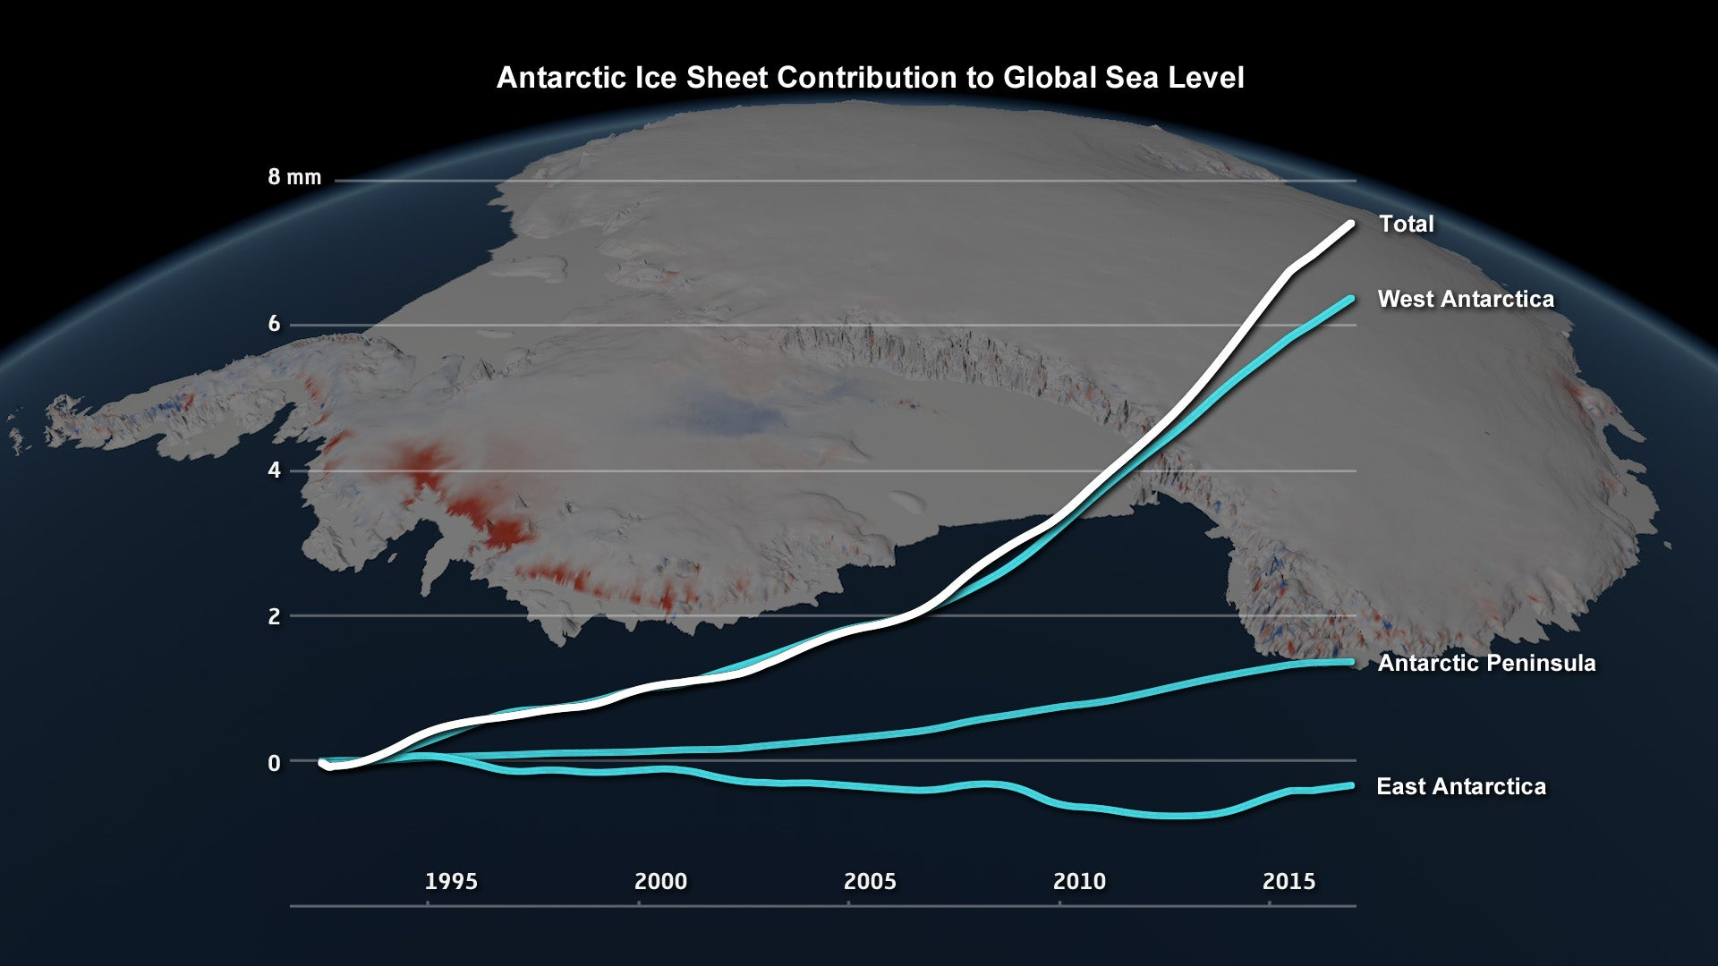
BACKGROUND
MORE HEAT IS TRAPPED
LOSS OF HIGH SURFACE REFLECTANCE
MORE MELT- OFF
Source - Antarctic Melt Rate Has Tripled in the Last 25 Years - Scientific American

Slide 4
OBJECTIVE – RESEARCH QUESTION
Research Objective:
To classify different zones of glacier using SAR backscatter seasonal analysis.
To do a temporal study of glaciers velocity.
Sub objectives:
Map Radar Glacier Zones (RGZ), using random forest classifier.
To plot and do an inferential study of pine glacier’s velocity.
Research Question:
How useful is Synthetic Aperture Radar in identifying and mapping glacier facies?
What is the accuracy of Random Forest classifier?
How has the glacier velocity changed over the year?

Slide 5
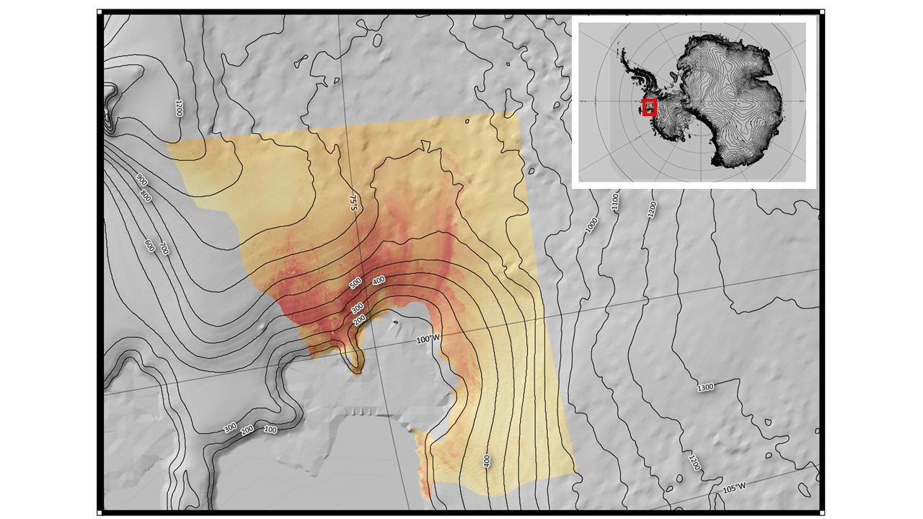
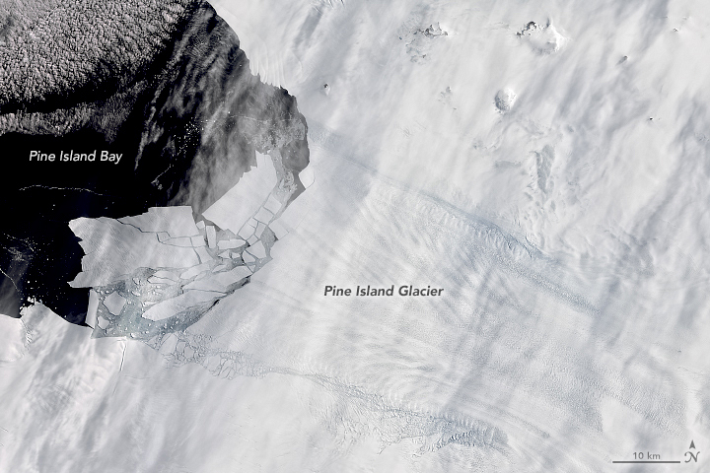
STUDY AREA
75.1667° S, 100.0000° W
LARGEST ICE STREAM 175,000 km²
+10 °C to −40 °C (Coastal) ; −30 °C to −80 °C (High Altitude)
SUMMERS – OCTOBER to MARCH
WINTERS – MARCH to OCTOBER

Slide 6
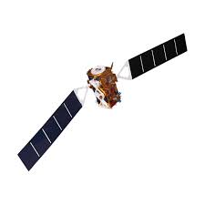
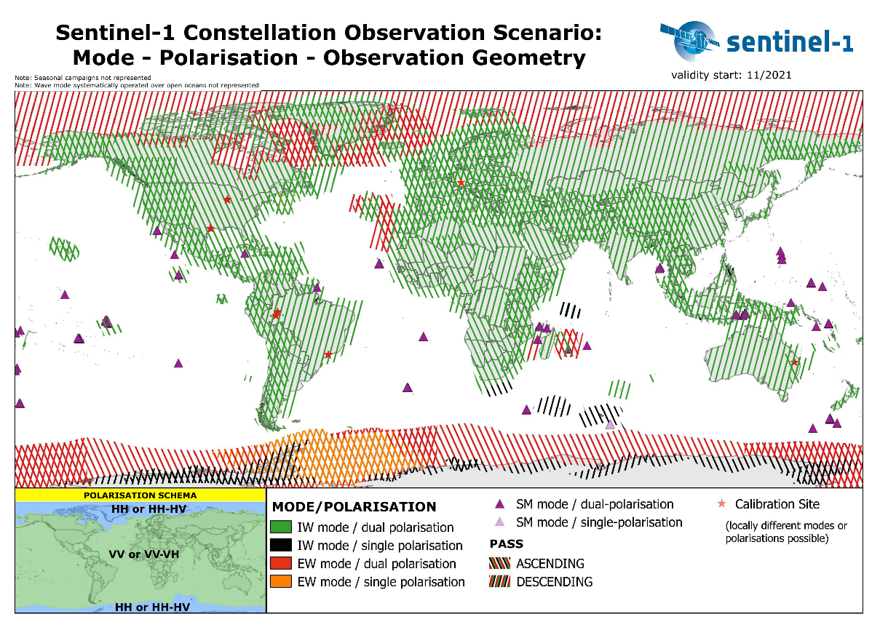
DATA-SET
Sentinel -1
C-BAND - 5.405GHz
10 Meter Resolution
IW - 250 km Swath width
HH - Polarization
DESCENDING PASS

Slide 7
SOFTWARES - TOOLS
Sentinel -1 SAR GRD Data
Refined Lee Speckle Filtering
RGB Composite
Red Band : Transition
Green Band : Summer
Blue Band : Winter
Image Pre-processing
(Orbital Corrections, Radiometric Calibration)
Terrain Correction
DEM
Supervised Classification
Geometric Correction
Convert Intensity to dB
Glacier Radar Zones
GOOGLE EARTH ENGINE GRD – Level 1 DATA

Slide 8

GOOGLE – EARTH ENGINE Sentinel – 1 Level 1 GRD DATA
Orbital corrections - Updates orbit metadata with a restituted orbit file (or a precise orbit file if the restituted one is not available).
GRD border noise removal - Removes low intensity noise and invalid data on scene edges. (As of January 12, 2018)
Thermal noise removal - Removes additive noise in sub-swaths to help reduce discontinuities between sub-swaths for scenes in multi-swath acquisition modes. (This operation cannot be applied to images produced before July 2015)
Radiometric calibration - Computes backscatter intensity using sensor calibration parameters in the GRD metadata
Terrain correction (orthorectification) - Converts data from ground range geometry, which does not take terrain into account, to σ° using the SRTM 30 meter DEM or the ASTER DEM for high latitudes (greater than 60° or less than -60°).

Slide 9
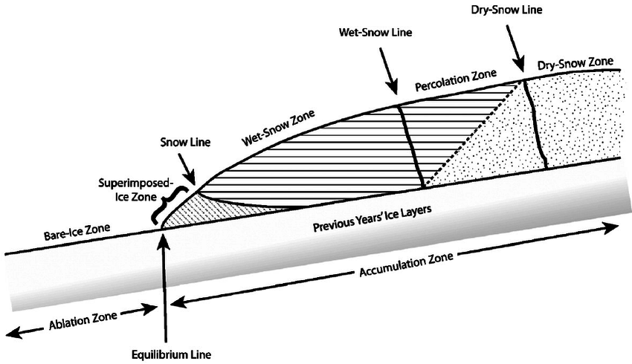
GLACIER RADAR ZONES
DRY ZONE - VOLUME SCATTERING
PERCOLATION ZONE – HIGH VALUE OF BACKSCATTER IN WINTER LOW IN SUMMER
WET ZONE – LOW BACKSCATTER
SUPERIMPOSSED - HIGH BACKSCATTER

Slide 10
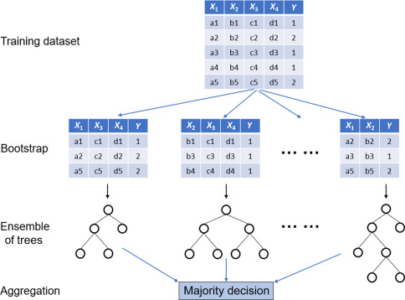
RANDOM – FOREST CLASSIFICATION
Ensemble – of Decision Trees
(Many Weak Learners Come to a Strong Decision)
Training Samples are collected
Bagging – Random Sampling with replacement
Random feature selection – To Split in child nodes
Predicts the class label for a given data point through the majority vote of all individual trees (RF regression often uses the mean of the values

Slide 11
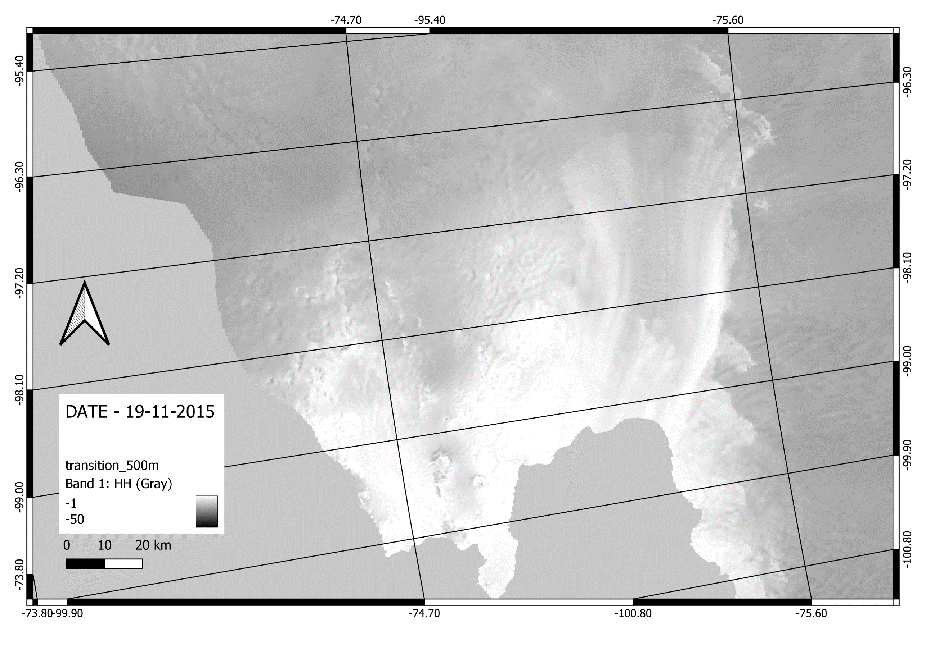
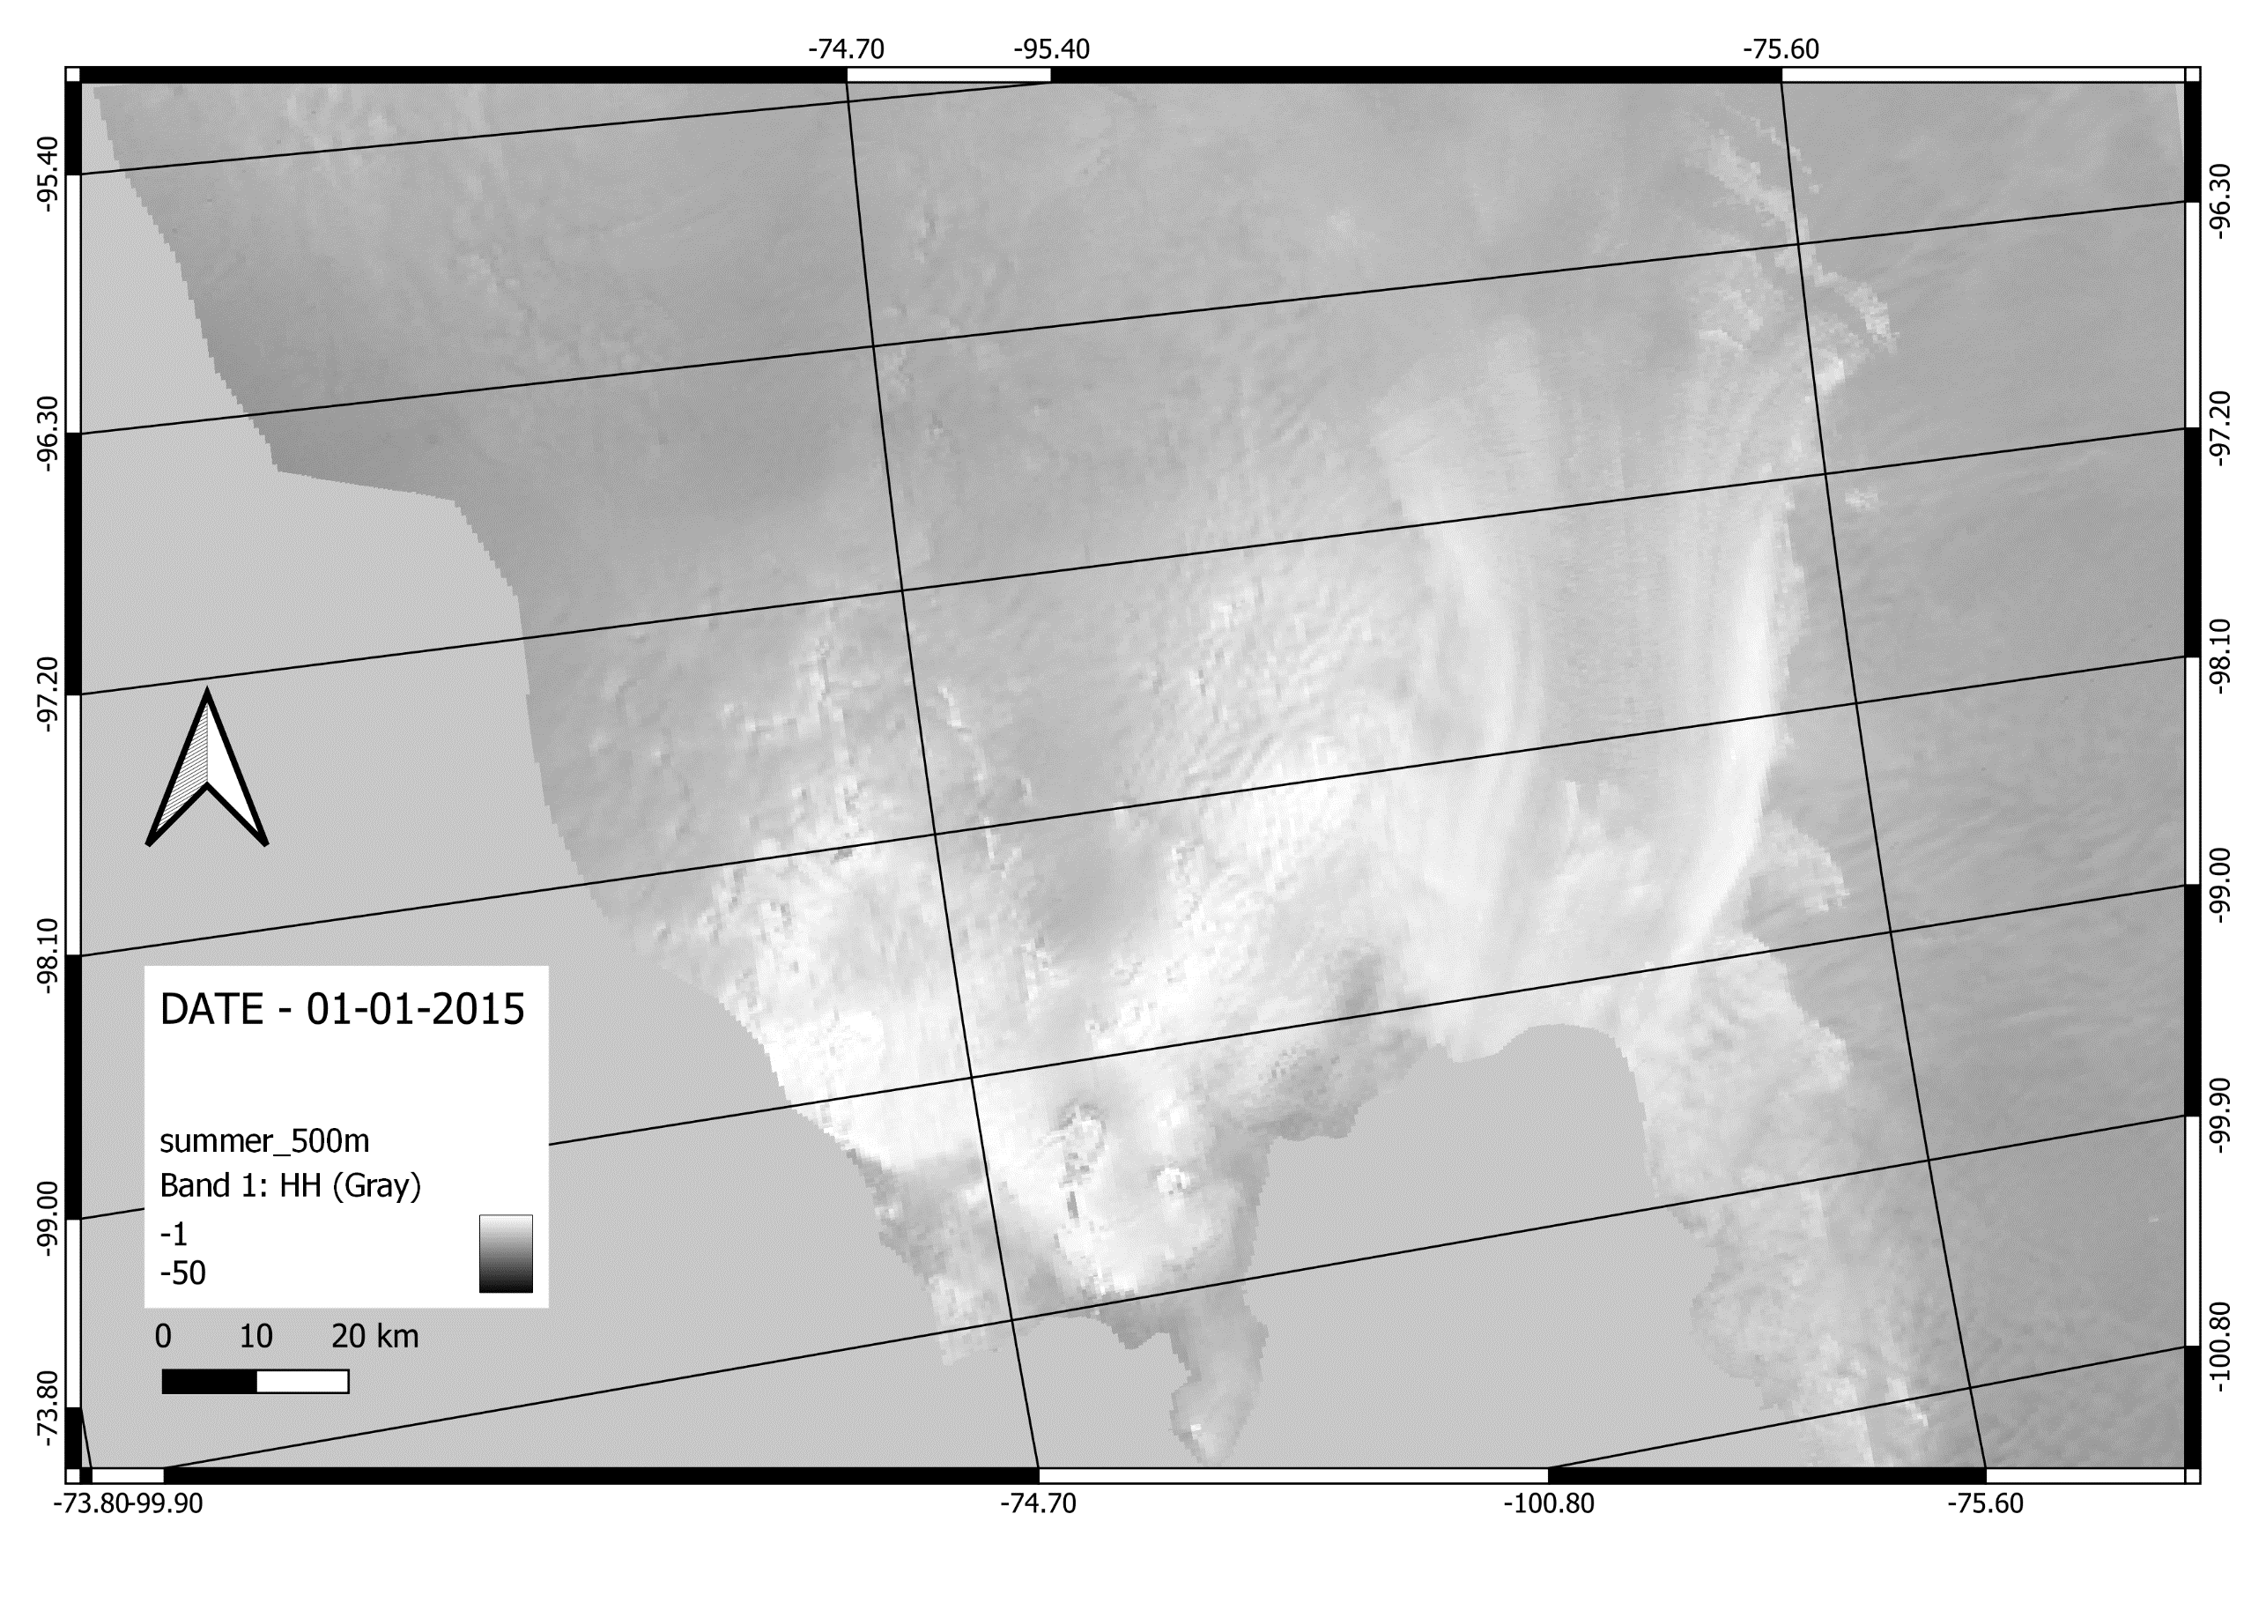
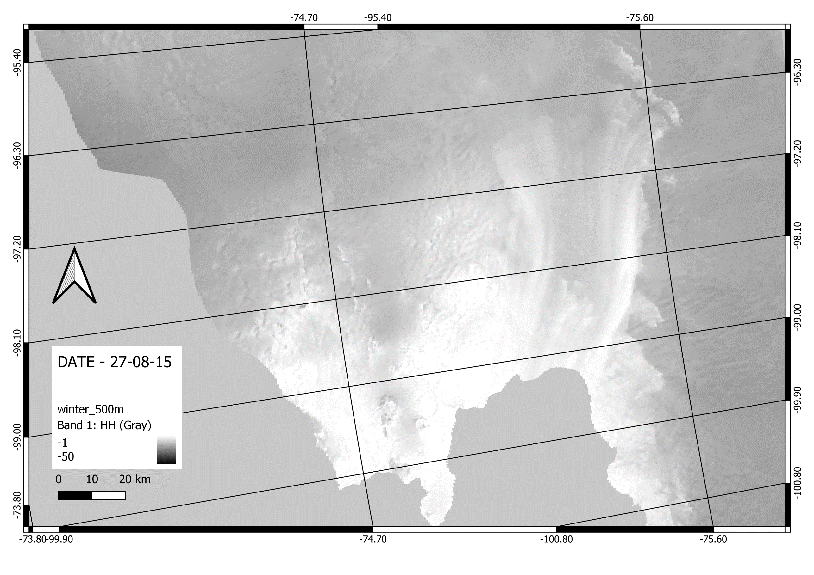
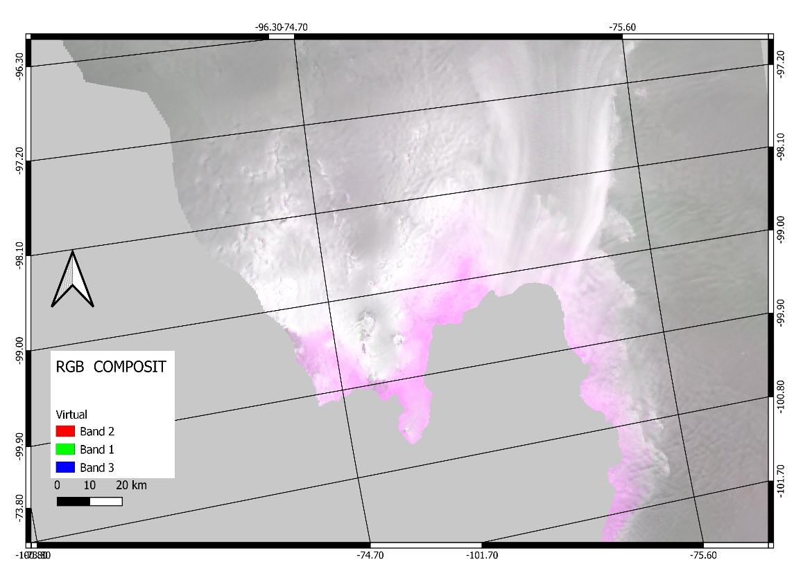
RESULTS
19-11-15
1-1-15
27-08-15
TRANSITION
SUMMER
WINTER

Slide 12
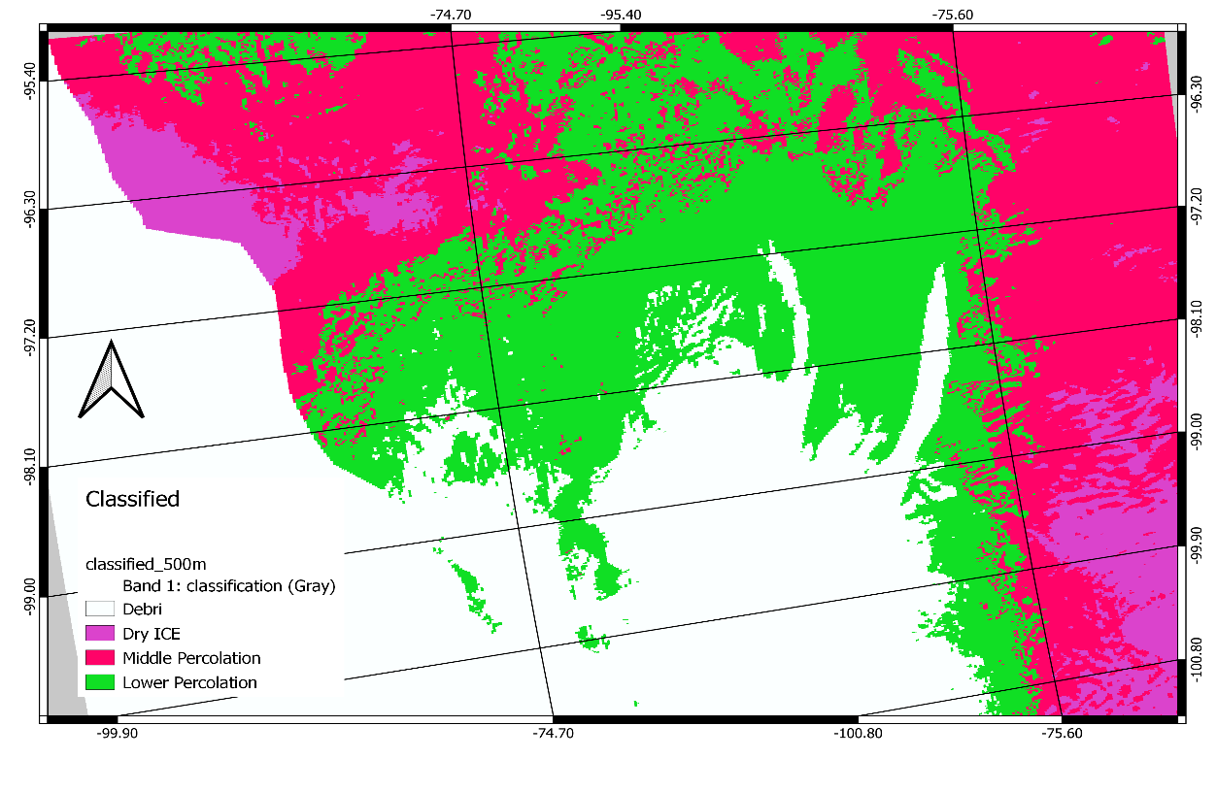
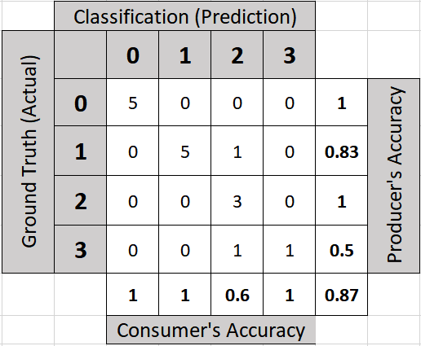
RESULTS
OVERALL – ACCURACY : 87%
Class 0 | Debris
Class 1 | Dry ICE
Class 2 | Middle Percolation
Class 3 | Lower Percolation
KAPPA – STATISTICS : 82

Slide 13
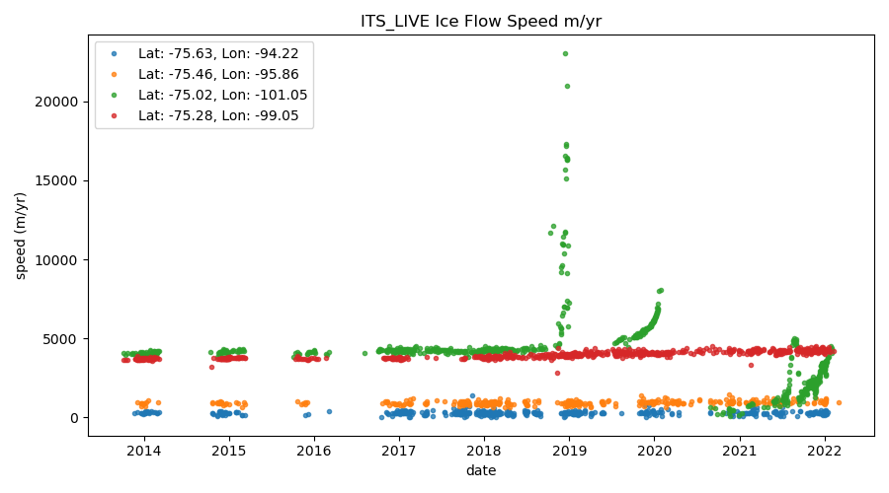

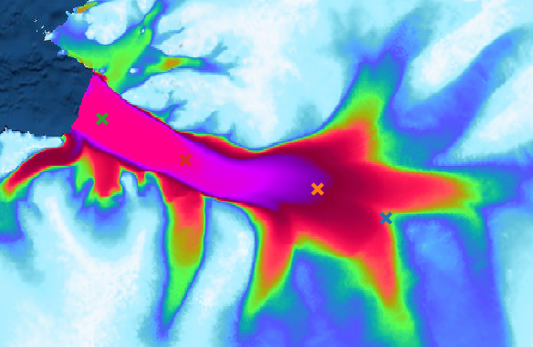
RESULTS

Slide 14
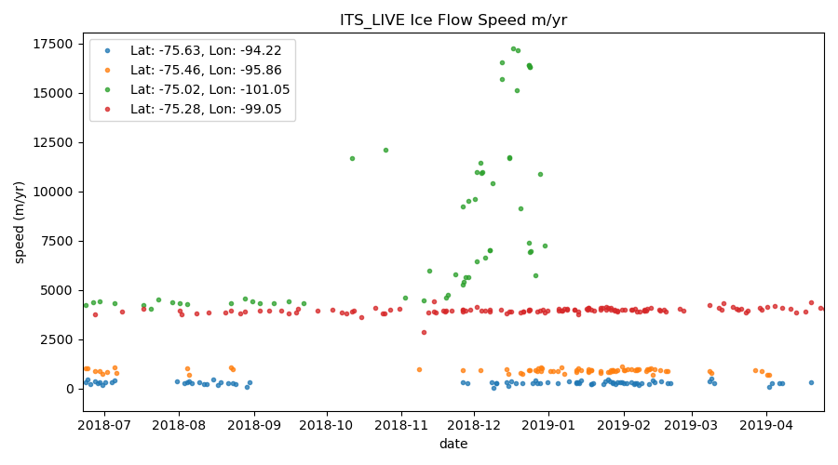
RESULTS

Slide 15
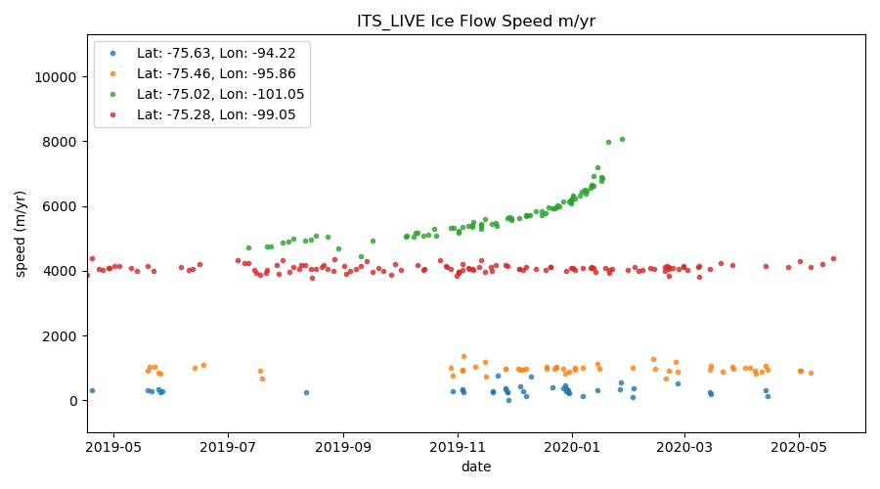
RESULTS

Slide 16
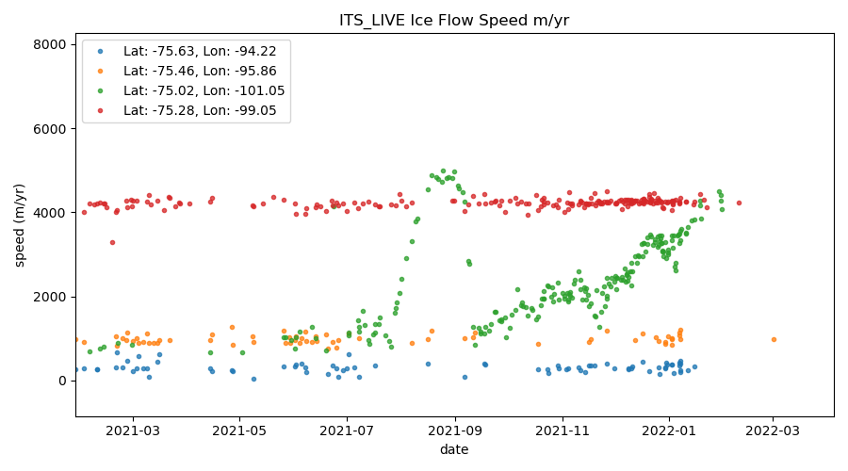
RESULTS

Slide 17
CONCLUSION
As the liquid water content of a glacier changes due to season, the glacier surface features would reflect different tonal variations using an RGB composite we can classify Radar Glacier Zones.
Random Forest classifier has a fairly good accuracy of 87 percent.
Glacier velocity has remained fairly stable, except in 2018, 2019, 2021 Summer season.

Slide 18
FUTURE - WORK - SCOPE
Exploration of other machine learning algorithms to classify RGZ, and for the year 2015-2021
Random Forest classifier has a fairly good accuracy of 87 percent.
Deeper analysis of Ice velocity in 2018, 2019, 2021.

Slide 19
REFERENCES
Arigony-Neto, J., Rau, F., Saurer, H., Jaña, R., Simões, J. C., & Vogt, S. (2007). A time series of SAR data for monitoring changes in boundaries of glacier zones on the Antarctic Peninsula. Annals of Glaciology, 46, 55–60. https://doi.org/10.3189/172756407782871387
Barry, R. G., Jania, J., & Birkenmajer, K. (2011). Review article “a. B. Dobrowolski - The first cryospheric scientist - And the subsequent development of cryospheric science.” History of Geo- and Space Sciences, 2(1), 75–79. https://doi.org/10.5194/hgss-2-75-2011
Belgiu, M., & Drăgu, L. (2016). Random forest in remote sensing: A review of applications and future directions. ISPRS Journal of Photogrammetry and Remote Sensing, 114, 24–31. https://doi.org/10.1016/J.ISPRSJPRS.2016.01.011
Bennett, M. R. (2003). Ice streams as the arteries of an ice sheet: Their mechanics, stability and significance. Earth-Science Reviews, 61(3–4), 309–339. https://doi.org/10.1016/S0012-8252(02)00130-7
Chouksey, A., Thakur, P. K., Sahni, G., Swain, A. K., Aggarwal, S. P., & Kumar, A. S. (2021). Mapping and identification of ice-sheet and glacier features using optical and SAR data in parts of central Dronning Maud Land (cDML), East Antarctica. Polar Science, 30, 100740. https://doi.org/10.1016/j.polar.2021.100740
De Vries, M. V. W., Bingham, R. G., & Hein, A. S. (2018). A new volcanic province: An inventory of subglacial volcanoes in West Antarctica. In Geological Society Special Publication (Vol. 461, Issue 1, pp. 231–248). Geological Society of London. https://doi.org/10.1144/SP461.7
ESA. (2022). Sentinel-1 - Missions - Sentinel Online - Sentinel Online. European Space Agency. https://sentinels.copernicus.eu/web/sentinel/missions/sentinel-1
European Space Agency (ESA). (2022). Sentinel-1- Observation Scenario - Planned Acquisitions. https://sentinels.copernicus.eu/web/sentinel/missions/sentinel-1/observation-scenario
GEE. (2021). Sentinel-1 Algorithms | Google Earth Engine | Google Developers. https://developers.google.com/earth-engine/guides/sentinel1
Hall, D. K., Ormsby, J. P., Bindschadler, R. A., & Siddalingaiah, H. (1987). Characterization of Snow and Ice Reflectance Zones On Glaciers Using Landsat Thematic Mapper Data. Annals of Glaciology, 9, 104–108. https://doi.org/10.3189/S0260305500000471
Hegerl, G. C., Zwiers, F. W., Braconnot, P., Gillett, N. P., Luo, Y., Orsini, J. A. M., Nicholls, N., Penner, J. E., & Stott, P. A. (2007). Understanding and attributing climate change. Contribution of Working Group I to the Fourth Assessment Report of the Intergovernmental Panel on Climate Change. In Climate Change
2007: The Physical Science Basis. (Vol. AR4, Issue May). https://www.researchgate.net/publication/272792548_Observations_Changes_in_Snow_Ice_and_Frozen_Ground_In_Climate_Change_2007_The_Physical_Science_Basis_Contribution_of_Working_Group_I_to_the_Fourth_Assessment_Report_of_the_Intergovernmental_Panel_on_C
Jones, R. W., Renfrew, I. A., Orr, A., Webber, B. G. M., Holland, D. M., & Lazzara, M. A. (1955). Journal of geophysical research. Nature, 175(4449), 238. https://doi.org/10.1038/175238c0
Joughin, I., Shapero, D., Smith, B., Dutrieux, P., & Barham, M. (2021). Ice-shelf retreat drives recent Pine Island Glacier speedup. Science Advances, 7(24), 3080–3091. https://doi.org/10.1126/sciadv.abg3080
THANK YOU

